Slide 1
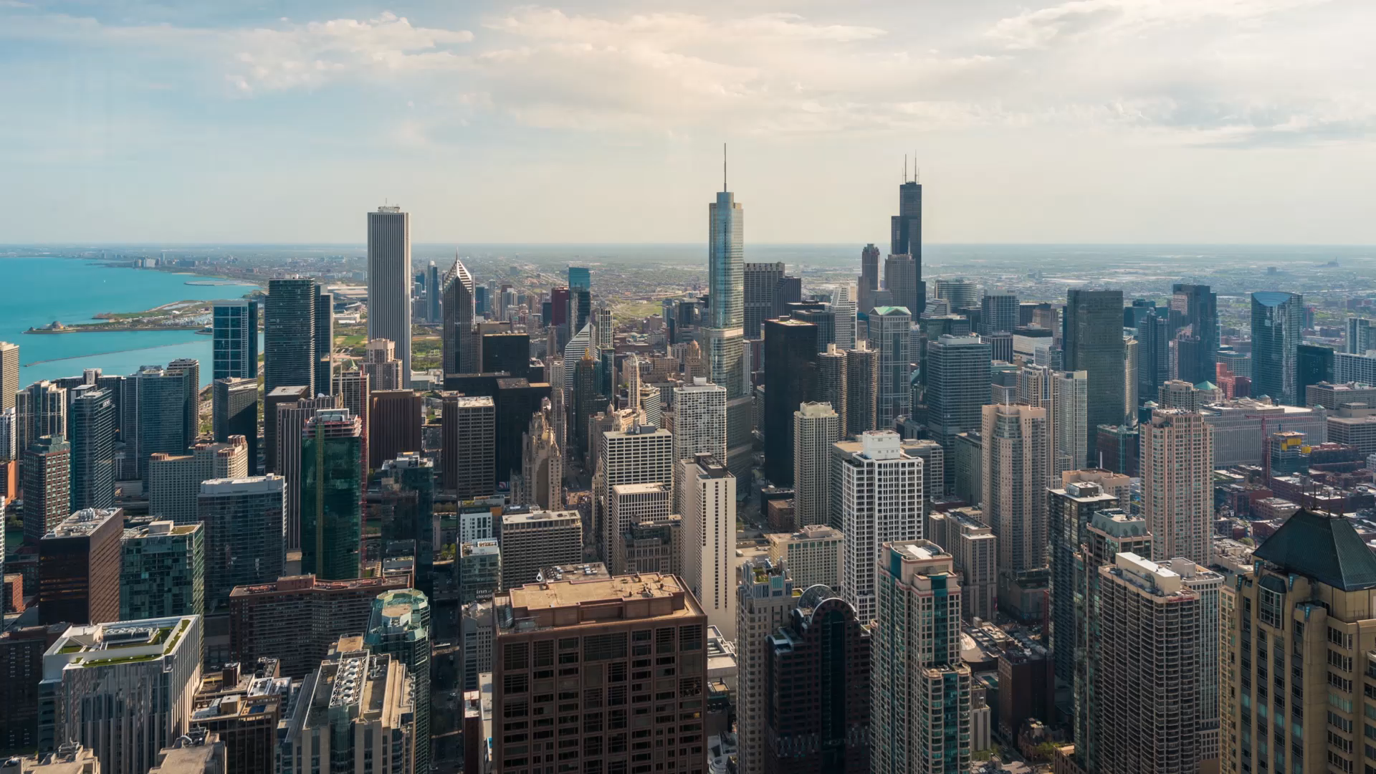
Environmental Monitoring Systems Using IoT
Martina Nolletti
Michele Intrevado
Giordano Tinella

Slide 2
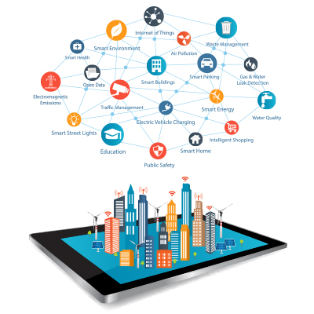
Introduction
Why we need an Environmental Monitoring System?

Slide 3
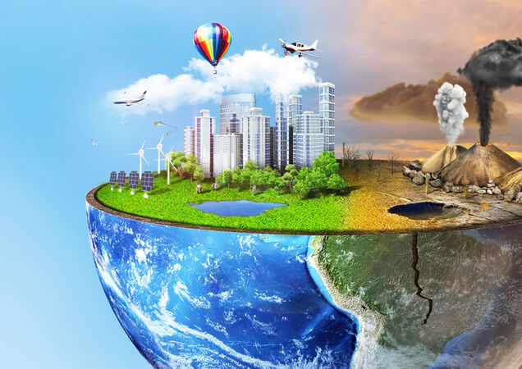

Introduction
How Environment impact our lives?
The consequences of the bad quality environment are:
Destruction of biodiversity;
Scarcity of drinkable water;
Diseases;
Infant mortality.

Slide 4
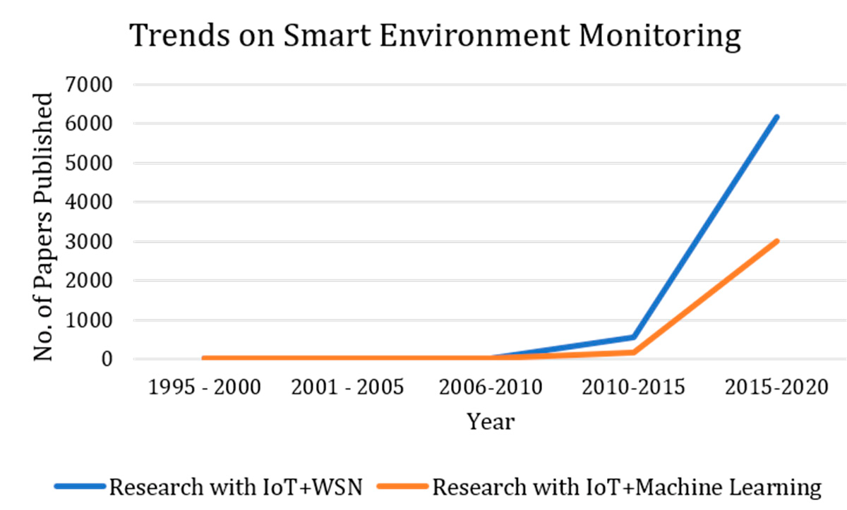
Background

Slide 5
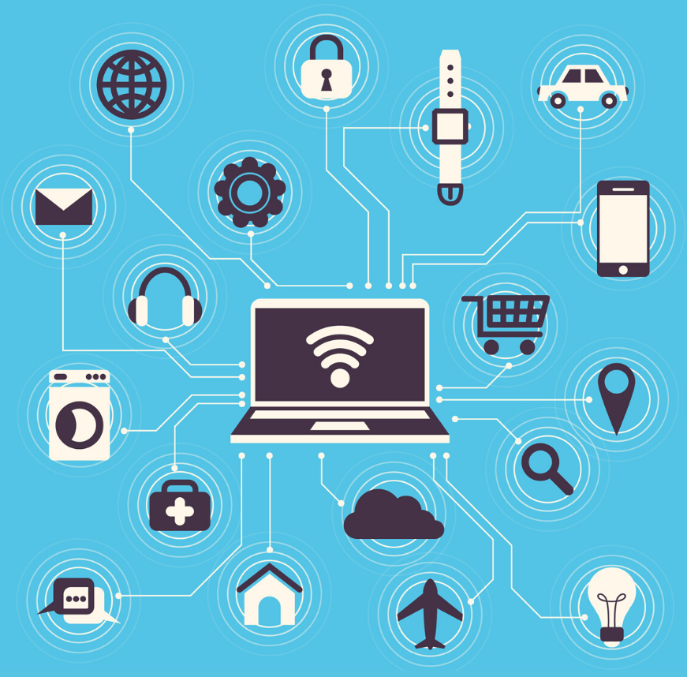
Background
General IoT architecture:
Sensors;
Micro-controller;
Actuators;
Cloud.

Slide 6
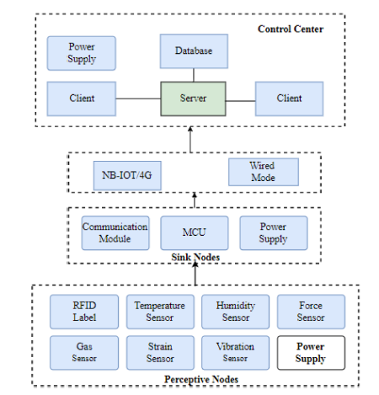
Background
Iot basic architecture:
perception layer;
network communication layer;
application layer.

Slide 7
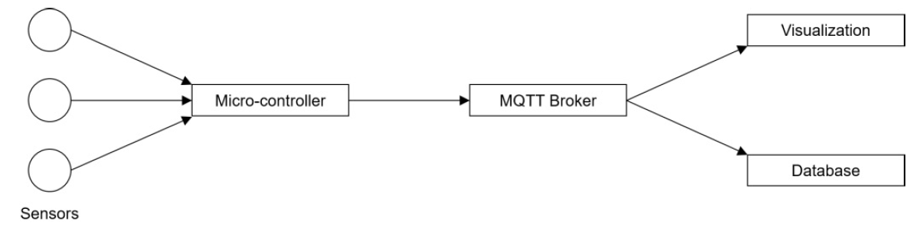
Background
Iot Basic architecture:
Measuring nodes: Micro controllers with sensors;
Message Broker: MQTT;
Data Storage and Visualization.

Slide 8
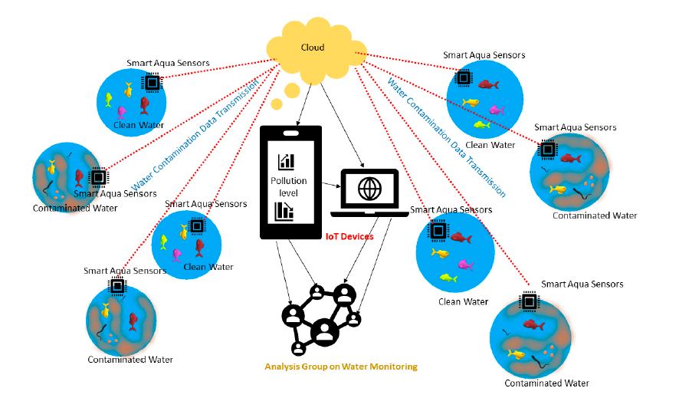
Existing Architecture
Smart environment monitoring system highlighting water contaminations and its monitoring using the cloud connecting internet of things (IoTs) and sensors.

Slide 9
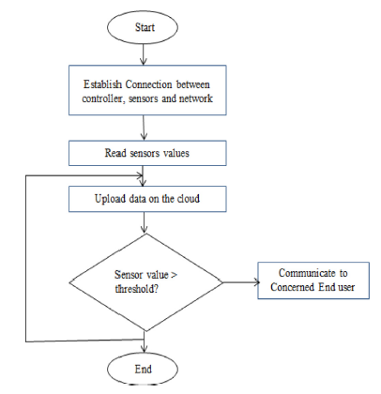
Existing Architecture
Other examples:
Mukta;
Konde and Deosarkar.

Slide 10

Observations
The extensive studies brings out the following major observations:
The research on SEM includes various purposes;
The methods are divided in terms of sensory data used, machine learning methods used, IoT devices used, and types of sensors involved;
The methods have been used for either classification or prediction.

Slide 11
Problems
The major challenges observed are as follows:
There is a problem of interoperability in the analysis of the data captured;
Sample size is limited in many of the contributions;
Noisy data poses a challenge in analysis;
The machine learning methods which have been employed for training the data and for classification;
There is no robust approach to machine learning reported.

Slide 12
Solutions
The solutions of the problems are:
A framework of machine learning methods needs to be developed;
A robust set of classification, prediction and forecasting models has to be designed;
Suitable denoising methods are required to be implemented as pre-processing to the SEM major stages;
Data deduplication approaches and other methods are needed to deal with big data issues;
SEM aims at sustainable development;
Developing suitable standards and protocols that can make the data compatible for all acquisition and analysis systems.

Slide 13
Conclusion
Environmental pollution is a major threat to any country, as it affects health, and the economy and spoils bio-diversity.
Several studies have already proven that the environmental conditions in the production area strongly affect the human performance.
Combining the necessity to incorporate these conditions to realize further improvements of production systems with the current opportunities provided by IoT applications, the need for an IoT-based monitoring of environmental conditions has been shown.

